Slide 1
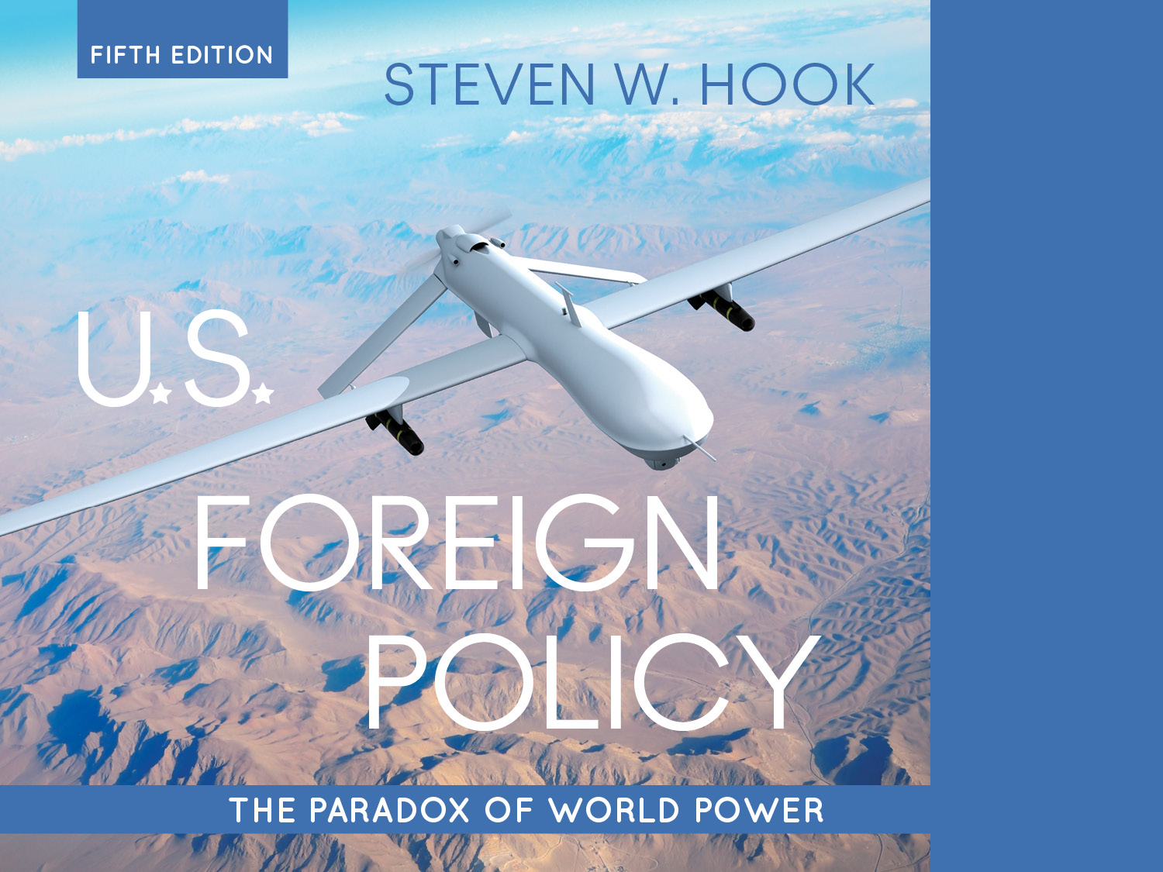
7. Public Opinion at Home and Abroad

Slide 2
Learning Objectives:
Today
Discuss the factors at play in the tensions between democratic governance and US foreign policy
a. Rival Views of Political Leadership
b. Mood Swings or Pragmatism?
c. America’s Knowledge Gap
Wednesday
Identify the shifts in public opinion since WWII
Describe the trends in the sources of news and information regarding US Foreign Policy
Discuss the ways in which various interest groups place pressures on foreign policy makers.

Slide 3
Public Opinion at Home and Abroad
Public opinion provides an essential guide for government action (democratic argument/accountability)
BUT, there are some issues with public participation:
Public is generally poorly informed about world affairs and global issues
Public tends to favor U.S. international involvement but is more interested in domestic affairs
Public also favors nationalistic policies in economic affairs
Large gaps in public opinion about U.S. foreign policy based on socioeconomic, regional, and other demographic factors
Public opinion also often fragmented and divided on key issues.
Notes:
Learning Objective number: 7.1

Slide 4
Public Opinion at Home and Abroad
Foreign policy behavior is constrained by public opinion but also dictates how the public thinks (circular relationship)
Do policymakers reflect public preferences?
Manipulating public opinion: Use of speeches, interviews, actions, and spinning political activities ( the "PR” Presidency)
Increasing importance of global public opinion in achieving foreign policy goals
Researchers interested in both the sources of public opinion and the effects of public opinion
Notes:
Learning Objective number: 7.1
Why is the importance of global public opinion increasing lately?

Slide 5
Chapter 7 Outline
I. Democracy and the Paradox of World Power
a. Rival Views of Political Leadership
b. Mood Swings or Pragmatism?
c. America’s Knowledge Gap
II. Public Opinion since World War II
a. Consensus and Discord during the Cold War
b. Public Ambivalence in the “New World Order”
c. Rallying around the Flag after 9/11
d. Foreign Policy Fatigue in the Obama Era
e. The View from Overseas
III. Group Identities and Foreign Policy Views
a. Physical Identities: Gender, Race, and Generation
b. Social Identities: Education, Wealth, and Religion
c. Political Identities: Ideology and Political Party

Slide 6
Democracy and the Paradox of World Power:
Democracy
Fundamental tensions between democratic governance and foreign policy
Uneven influence on government (interests groups)
Difficulty in government openness
Electoral pressures
Economic and political pressures
Interstate system conflicts and realities
Public opinion in democracies matters!
Problem of procedural vs substantive democracy in the U.S. context.
Notes:
Learning Objective number: 7.1
Which ones of these are not clear? Give you a chance to ask questions.
What about the last point, let us discuss that one.

Slide 7
Democracy and the Paradox of World Power
The public
Mass public: Neither very informed nor interested in foreign policy issues
Attentive public: Pays closer attention to world affairs and involved in policy process
Elite public: Both the interest and means to participate in U.S. foreign policy
Notes:
Learning Objective number: 7.1
There are a couple of things we should think about when it comes to the relationship between public opinion and FP in a democracy. Whose opinion and who makes opinion

Slide 8
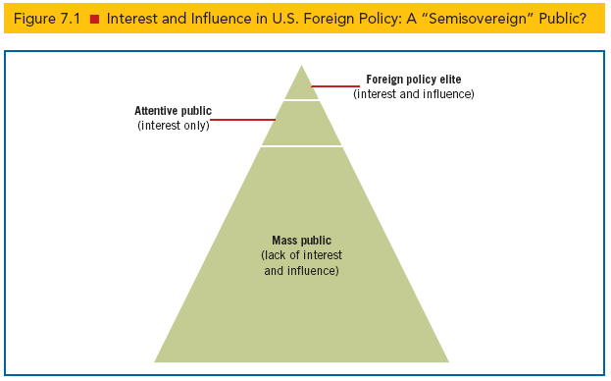
Democracy and the Paradox of World Power
Notes:
Learning Objective number: 7.1

Slide 9
Rival Views of Political Leadership
Delegate model: Elected officials make decisions that directly reflect preferences of public majority
Often linked to variants of liberal thought about human nature (positive and cooperative)
Examples
President Carter: Promotion of human rights
President H. W. Bush: Response to Iraq invasion of Kuwait
President Obama: Withdrawal of troops from Iraq and Afghanistan, refusal to commit to military involvement in Syria
President Trump?
Notes:
Learning Objective number: 7.1
Another way we can think about this is to think how leaders respond to public opinion and “the people”
Is there an example of a delegate model decision making procedure , not necessarily in the U.S. lately?

Slide 10
Rival Views of Political Leadership
Trustee model: Elected officials use their own judgment and experience to determine what is best for the public
Often associated with realist thought about human nature (pessimistic and irrational)
Examples
President Clinton: Kosovo intervention
President Bush: Iraq war without UN Security Council resolution
President Trump?
Notes:
Learning Objective number: 7.1

Slide 11
Mood Swings or Pragmatism?
Debate over public intellect regarding foreign affairs
Long history of public being viewed as ignorant and uninterested in foreign affairs (and also having “mood swings”)—the “apathy problem”
Almond–Lippmann consensus based on Gallup polls during the late 1940s and 1950s
Public opinion is . . .
Volatile: Shifting on each issue
Incoherent: Lacking reason, roots, and principles
Irrelevant: Policy makers are detached from and tend to ignore public opinion
Notes:
Learning Objective number: 7.1

Slide 12
Mood Swings or Pragmatism?
Almond-Lippman consensus challenged by more recent research detecting more coherence and consistency
Support for multilateral cooperation
Most favor internationalist foreign policy
More protectionism/nationalism on economic issues
Real question today: Should the United States pursue militant internationalism or cooperative internationalism?
Is there another question we should ask in 2019?
The role of international trust in opinion formation
What is public opinion?
At its core, it is the belief systems of individuals whose normative values and presumptions about human nature, the state, and society shape their judgments about foreign policy.
Notes:
Learning Objective number: 7.1
The second point overlaps with what distinction?

Slide 13
Mood Swings or Pragmatism?
Public offers reasoned responses based on values, perceptions, and experiences
Level of international trust
Case-by-case basis
Varies by issue area, such as military vs. economic foreign policies
Political party stances and influences
Latent public opinion or ingrained sets of values and methods of evaluating the world can lead to a “pretty prudent public”
React to situations on a logical basis, such as casualties in war
Notes:
Learning Objective number: 7.1

Slide 14
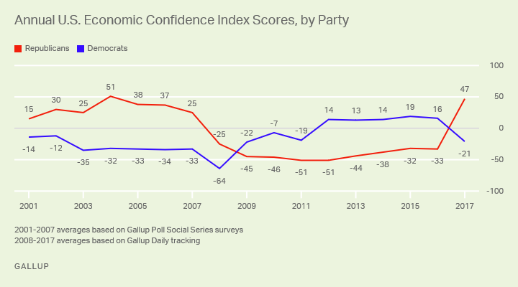
Mood Swings or Pragmatism?

Slide 15
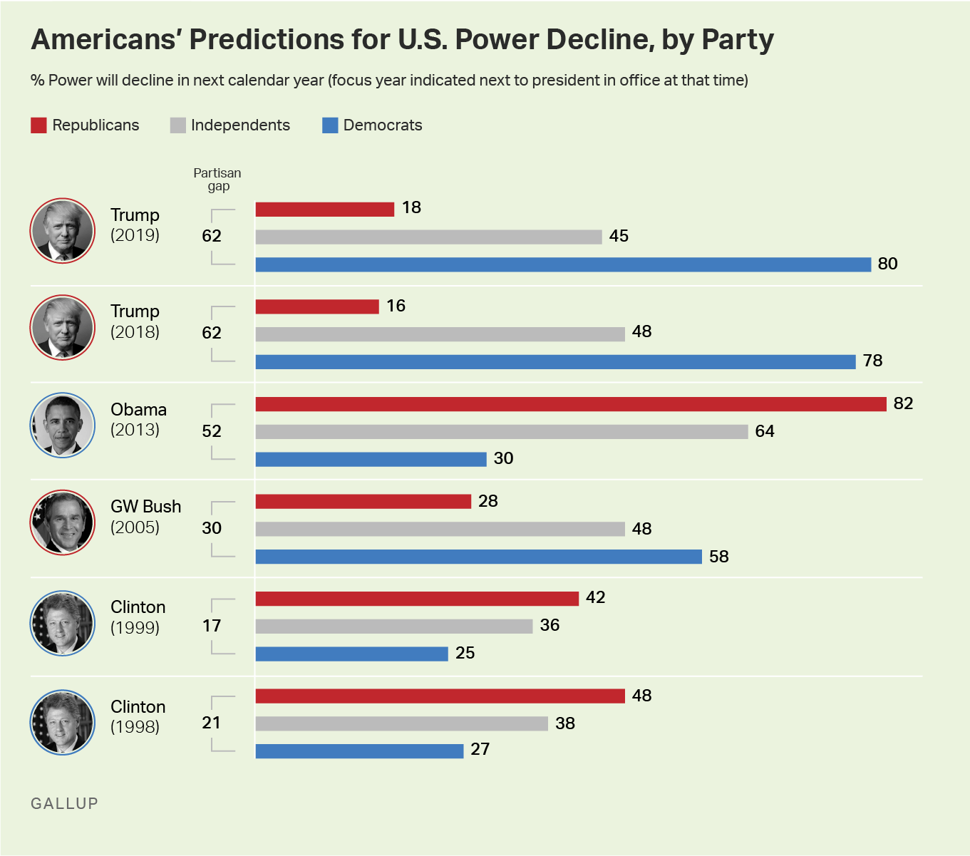
Americans’ view on U.S. World Power

Slide 16
Americas Knowledge Gap
U.S. citizens are poorly informed about the world
Cultural detachment in geography and political culture
U.S. educational system focused on American history and government, not global history and politics
U.S. citizens have trouble identifying countries on maps and naming foreign leaders
Critical knowledge gaps also persist among members of the foreign policy elite.
Notes:
Learning Objective number: 7.1

